Slide 1
Goal
The dynamics of CPU footprints are correlated with the program’s secrets and allow accurate adversarial inference.
We can use magnetometer on mobile phones to detect other machine’s CPU footprints without physically touch the victim.
Information leakage
Programs / web sites
User’s interests, relationship to the sites/programs, etc

Slide 2
PowerPoint
Word
Excel
Chrome
Firefox
Skype

Slide 3
Reason for the Patterns
Correlation Coefficient
- CPU usage =92%
- Networks =35%
- Disks read =6%

Slide 4
Experiments
1. PowerPoint 2. Word 3. Excel 4. Google Chrome 5. Firefox 6. Safari 7. Skype 8. iTunes 9. VLC Player 10. MPlayer
Each experiment consists of 10 runs. In each run, 10 programs are opened and closed in turn.
Conduct experiments in Taiwan, HongKong, Shangzheng, and Nanjing. The relative position between phone and laptop is different each time.

Slide 5
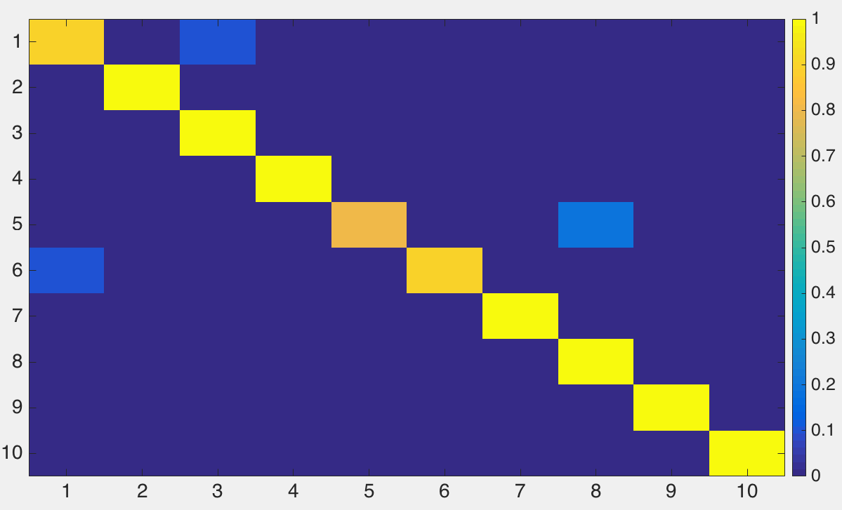
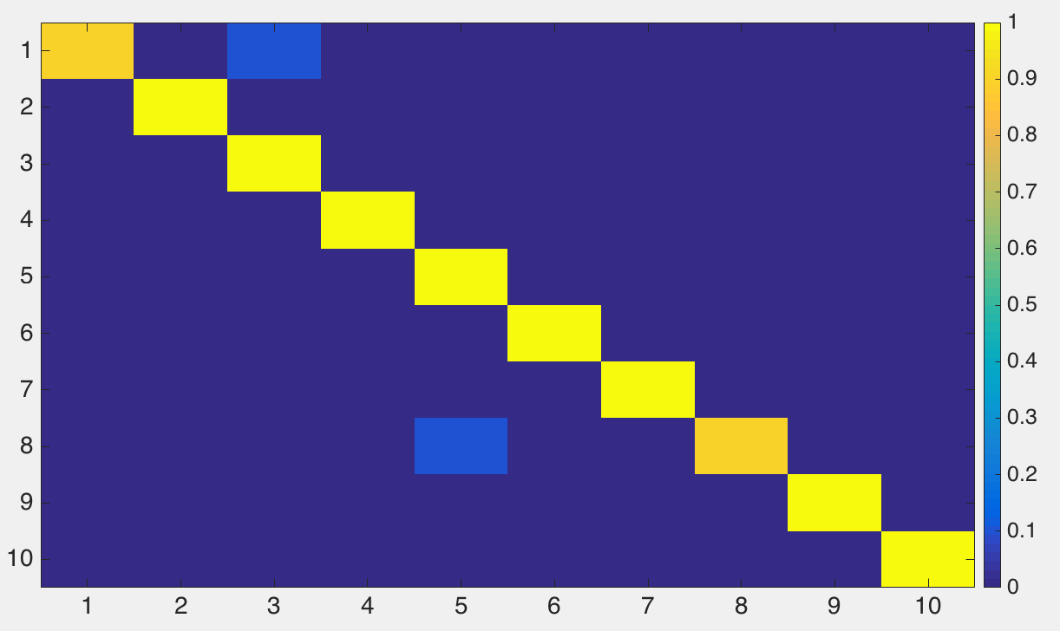
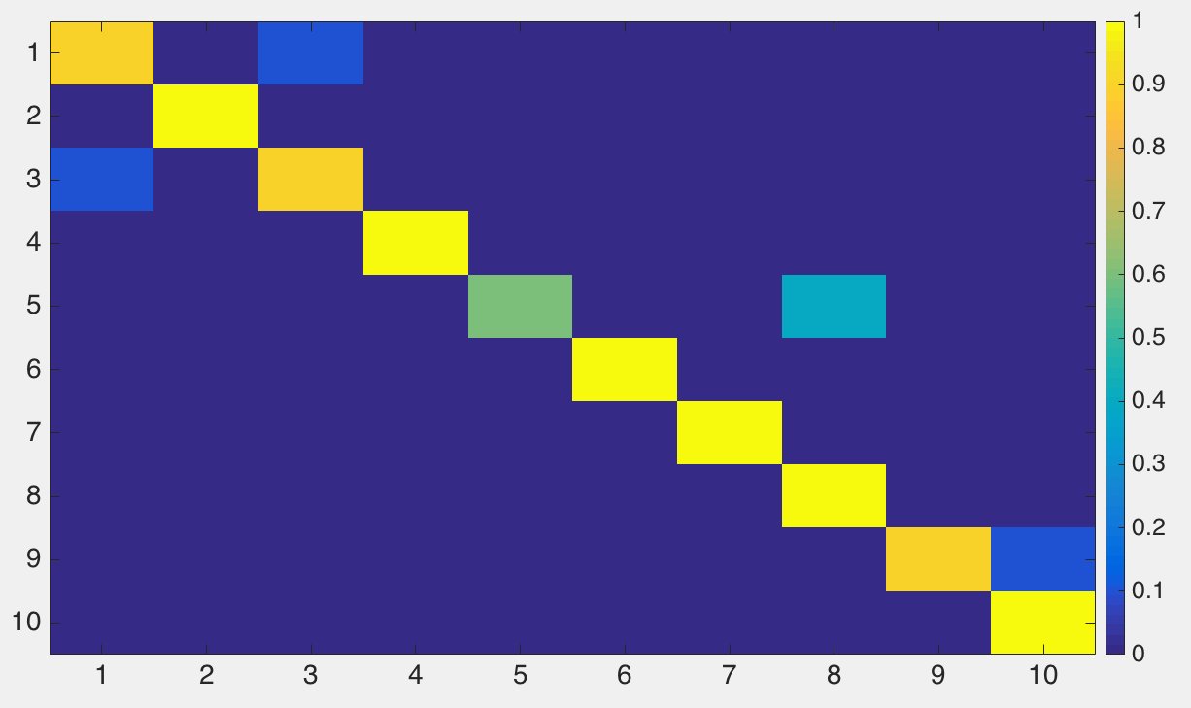
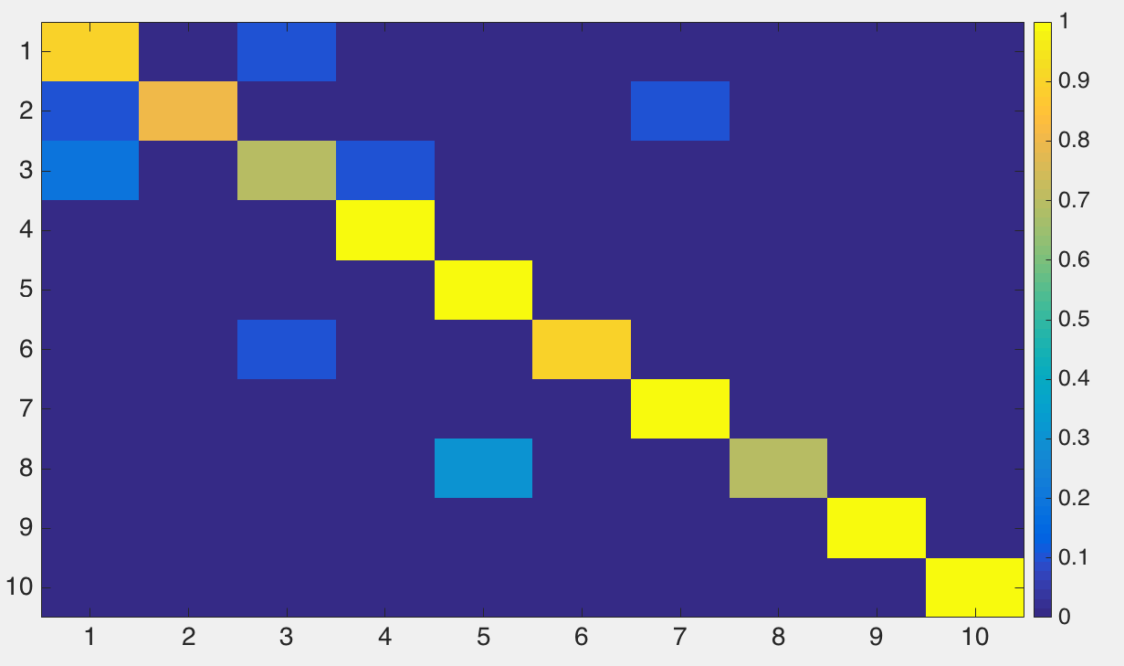
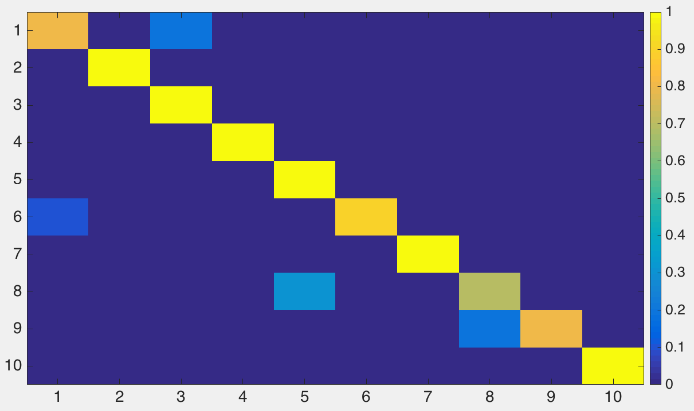
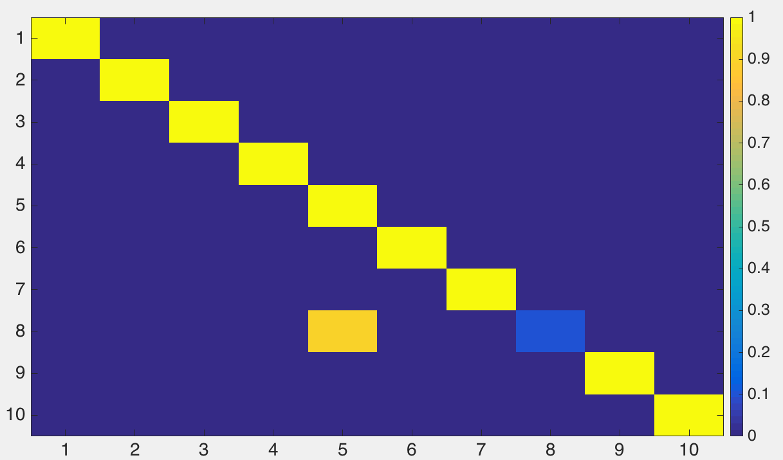
Confusion Matrix
Test: HongKong
Train: Shangzheng
Test: Shangzheng
Train: HongKong
Test: Nanjing
Train: HongKong
Program
Classified as
Test: HongKong
Train: Nanjing
Test: Shangzheng
Train: Nanjing
Test: Nanjing
Train: Shangzheng

Slide 6
Existing Works
https://www.tau.ac.il/~tromer/mobilesc/
They use specially built tool to decode RSA’s (or other encryption method) key.
We focus on using off-the-shelf mobile phones to detect users’ interest/behavior

Slide 7
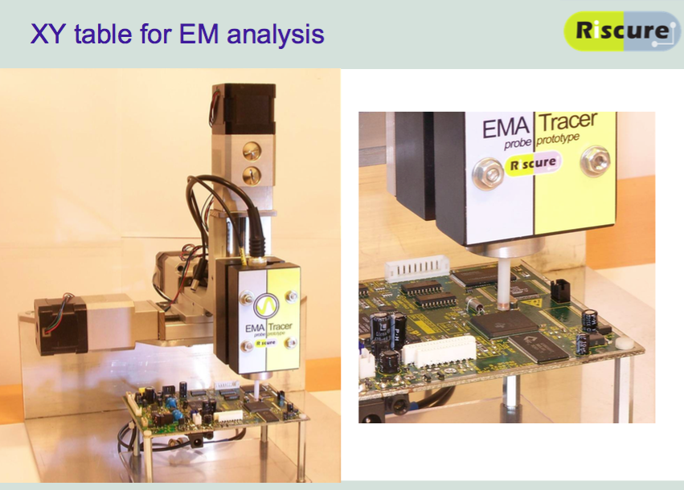

Slide 8
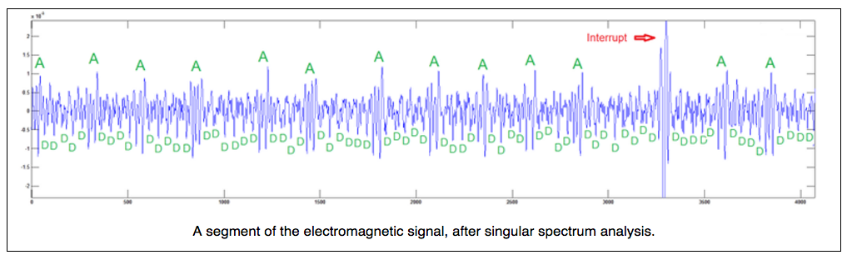
Decode RSA Key
Sampling rate = 200KHz

